Slide 1


Is caring for an ill or aging loved one affecting your own health?
You aren’t alone. Seventy percent of caregivers admit being so focused on their duties that they put off addressing their own needs.
Being a caregiver isn’t easy, but there are benefits to help.
Source: Fidelity Investments, “2022 American Caregivers Study: The Facts on Disability & Special Needs Planning,” https://www.fidelity.com/bin
public/060_www_fidelity_com/documents/about-fidelity/FidelityInvestments_CaregiversFactSheet.pdf.
© 2024 FMR LLC. All rights reserved. 1109563.2.0

Slide 2

Simultaneously caring for both children and an ill or aging loved one? You’re in the ‘sandwich generation.’
Half of those caring for both children and other loved ones said that their financial situation was fair or poor.
Being a caregiver isn’t easy, but there are benefits to help.
BUT DID YOU KNOW?
Source: Fidelity Health® Thought Leadership Health Benefits Consumer Survey, fall 2022.
© 2024 FMR LLC. All rights reserved. 1109563.2.0

Slide 3
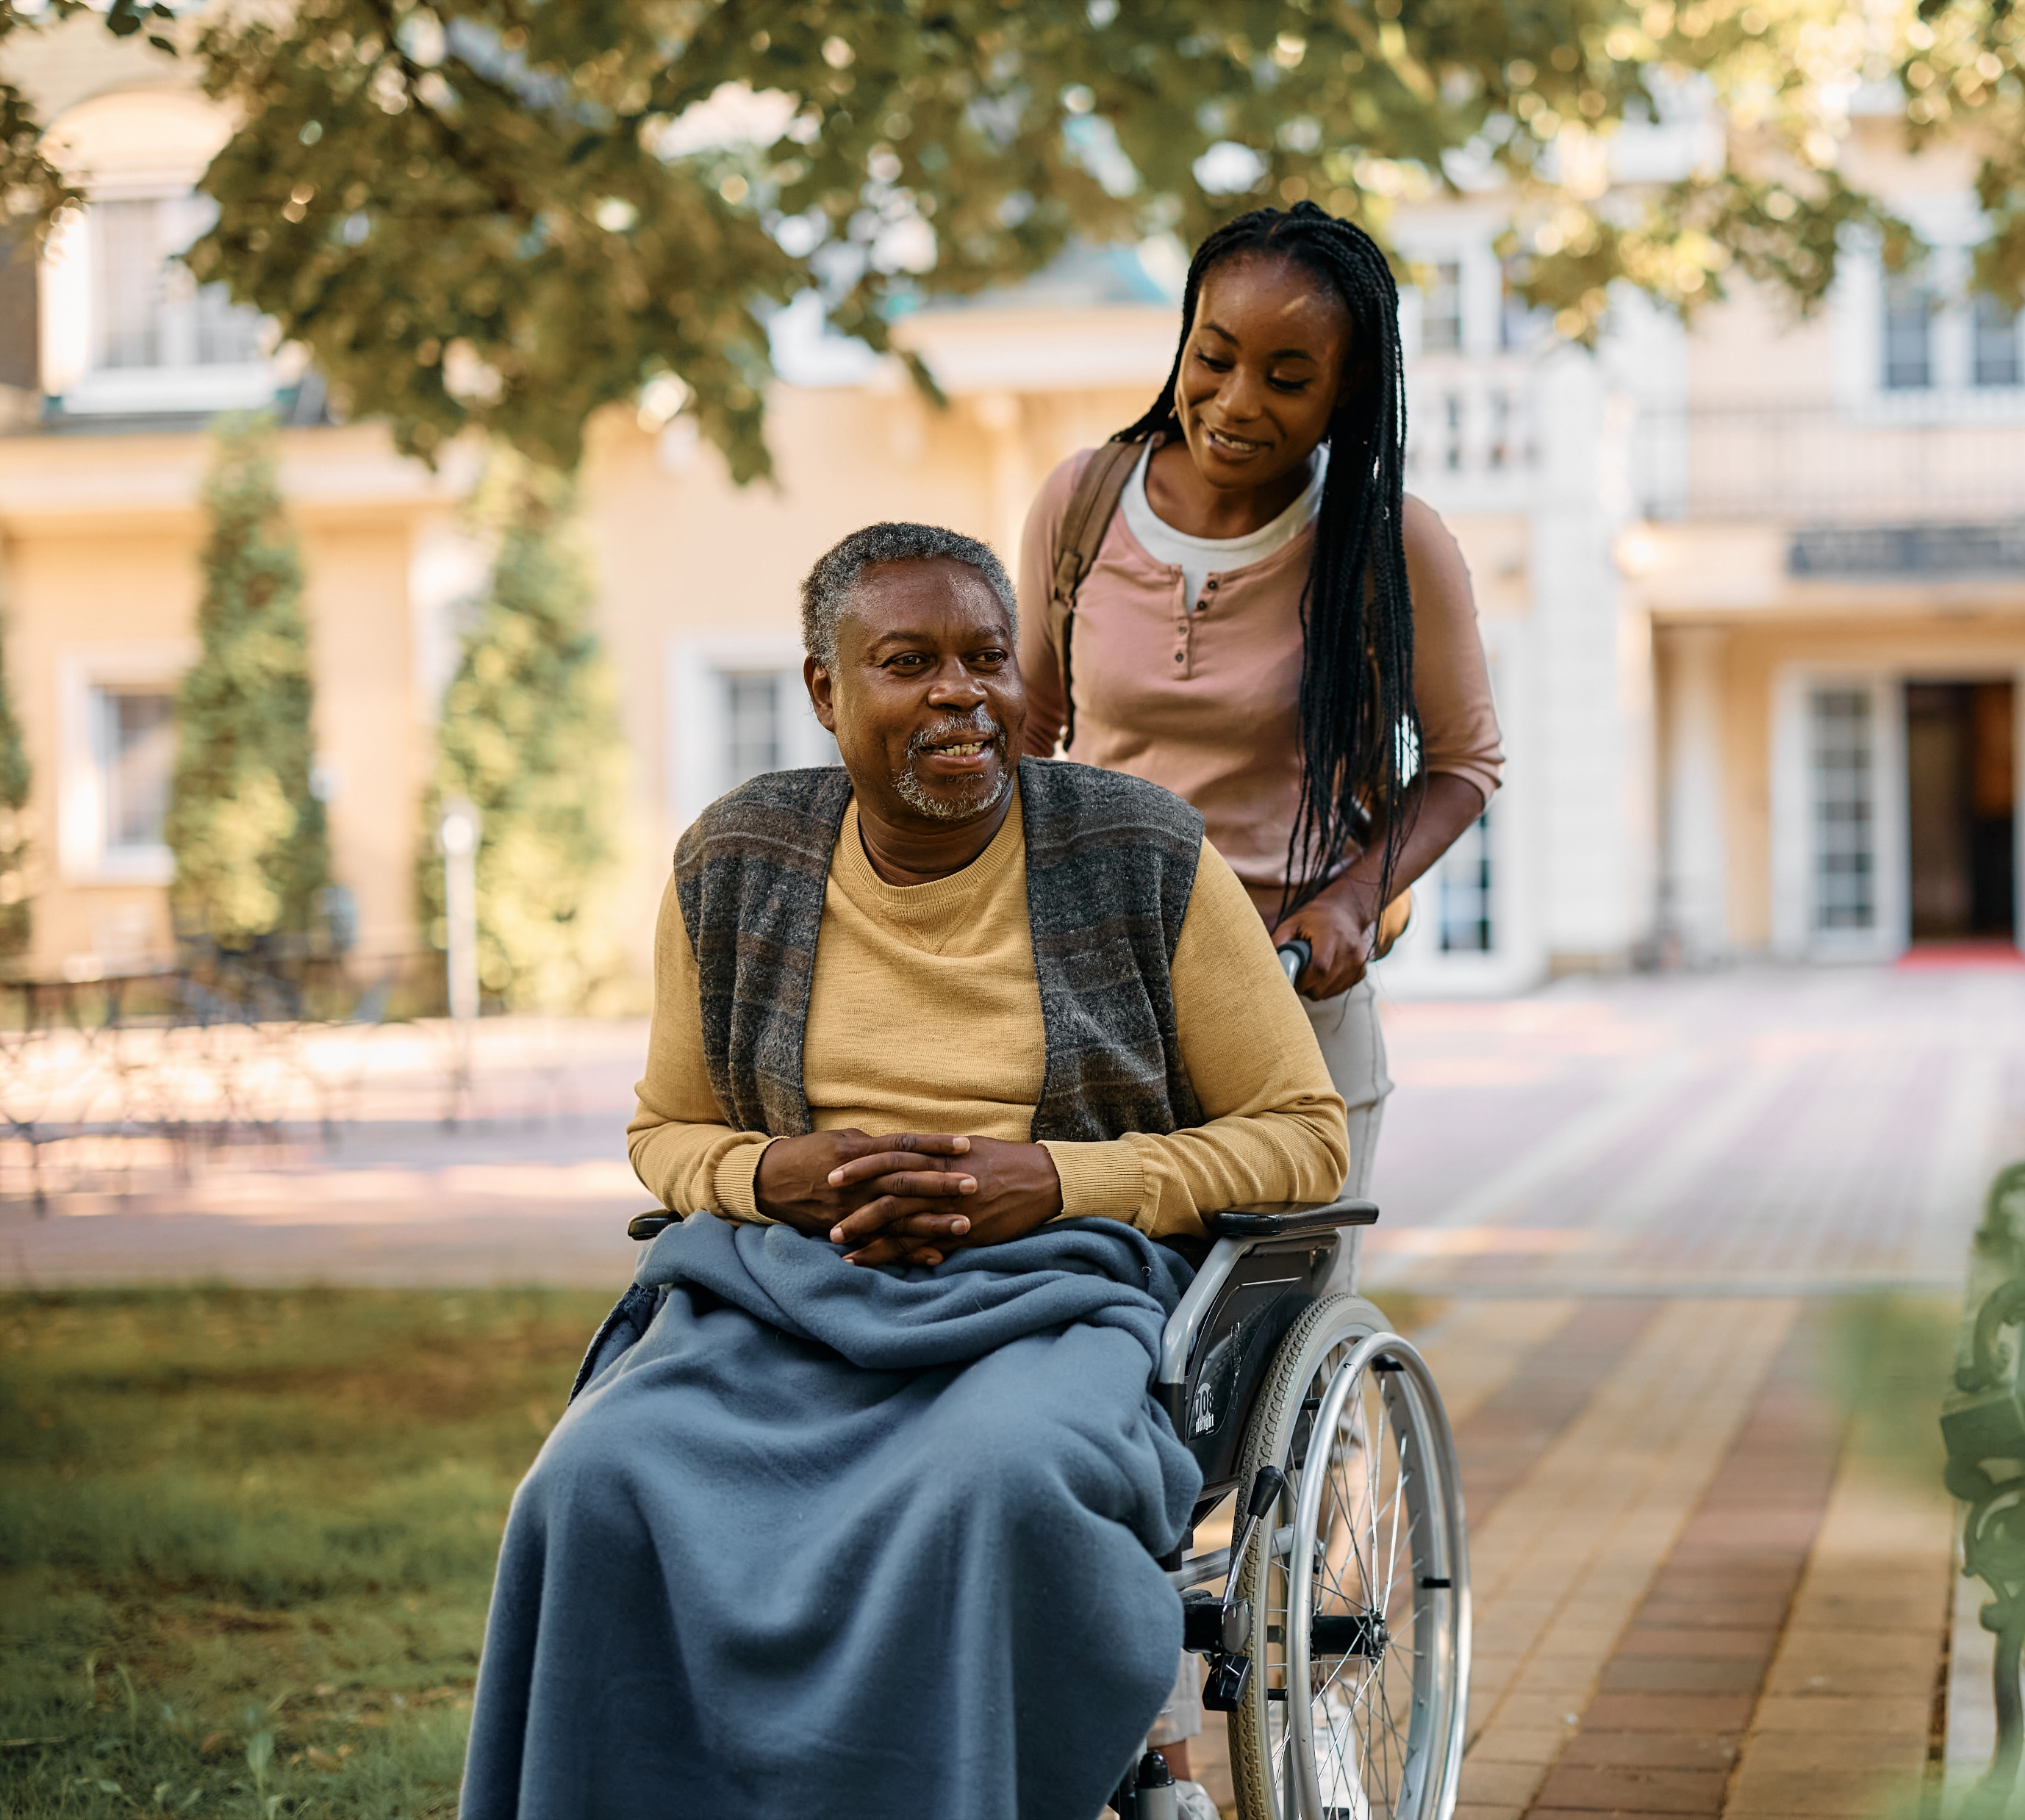
Feeling the strain of caring for an ill or aging loved one? Your employer may offer benefits to support you.
More than one in five caregivers said they didn’t know if their employer offered caregiving benefits.
Explore benefits that could help you today.
BUT DID YOU KNOW?
Source: Fidelity Health® Thought Leadership Health Benefits Consumer Survey, fall 2022.
© 2024 FMR LLC. All rights reserved. 1109563.2.0

